Slide 1
INTRODUCTION TO WEB DEVELOPMENT - SESSION 4
Katerina Veloska- kveloska@gmail.com

Slide 2


SOME PROBLEMS PROGRAMMERS FACE
Naming things is really hard
Finding mistakes and broken things ( bugs )
Fixing mistakes and broken things ( bugs )
@SEDC 2018-2019

Slide 3
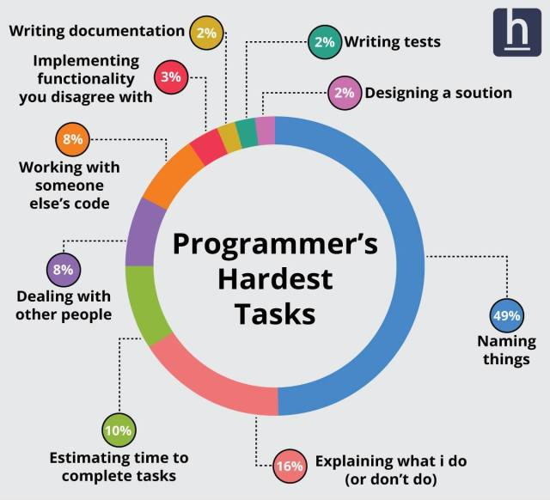

Slide 4
What’s in a name?
Must be descriptive
Must be unique
Must not be too short
Must not be too long
Must follow standards

Slide 5
What’s in a name?
Should reveal intention
(d, list1, theList, query)
Should avoid disinformation
(AccountList, l, O)
Should be meaningful
(a1, a2, .. aN; Product/ProductInfo/ProductData,
variable, table, NameString)
Should be pronounceable
(DtaRcrd102)

Slide 6
What’s in a name?
Should use nouns and verbs correctly
GetName, SetName, ChangeName
Should have one word per concept
get, fetch, retrieve - controller, manager, driver
Should have correct opposites
Start with Stop, Open with Close

Slide 7
What’s in a name?
Should be consistent
employee.id.Get()
dependent.GetId()
supervisor()
candidate.id()
Should use solution / problem domain names correctly
Solution domain names (geek terms) for low level code
Problem domain names for high level – conceptual code
Best App Ever – BAEAccountAddress, BAECustomer

Slide 8

Problem solving is a process
@SEDC 2018-2019

Slide 9

THE PROCESS OF PROBLEM SOLVING
Understanding the problem
Devising a plan
Execution of the plan
Looking back
@SEDC 2018-2019

Slide 10
UNDERSTANDING THE PROBLEM
What is the unknown?
What is the data?
What is the condition? Is it possible to satisfy the condition?
Is the condition sufficient to determine the unknown?
Draw a diagram. Introduce suitable notation.
@SEDC 2018-2019

Slide 11
DEVISING A PLAN
Have you seen the problem before? Do you know a related problem?
Look at the unknown. Think of a problem having the same or similar unknown.
Split the problem into smaller sub-problems.
If you can’t solve it, solve a more general version, or a special case, or part of it
@SEDC 2018-2019

Slide 12
EXECUTION OF THE PLAN
Carry out your plan of the solution. Check each step.
Can you see clearly that the step is correct?
Can you prove that it is correct?
@SEDC 2018-2019

Slide 13
EXECUTION OF THE PLAN
Can you check the result?
Can you derive the result differently?
Can you use the result, or the method, for some other problem?
@SEDC 2018-2019

Slide 14
TASK I
Write a simple program that makes a Miles in Kilometers conversion
1Mile = 1.60934Km
Time to complete: 10 - 15 minutes
@SEDC 2018-2019

Slide 15
TASK II
Write a program that finds the average of 3 inputs and prints it out
Time to complete: 10 - 15 minutes
@SEDC 2018-2019

Slide 16
TASK III
Write a program that finds a specific name of student out of a collection of students
Time to complete: 10 - 15 minutes
@SEDC 2018-2019

Slide 17
TASK IV
Given these coin denominations: 1¢, 5¢, 10¢, 20¢, 50¢, and $1, find the smallest number of coins needed for a given amount. You do not need to list out what coins are used. Example 1: For 375 cents, 6 coins are needed. Example 2: For 543 cents, 10 coins are needed.
Time to complete: 20 - 25 minutes
@SEDC 2018-2019

Slide 18
TASK
Let's program our way to CodeCombat!
https://codecombat.com/students?_cc=MixBallSharp
Code: MixBallSharp
@SEDC 2018-2019

Slide 19

Time for questions!
@SEDC 2018-2019

